Slide 1
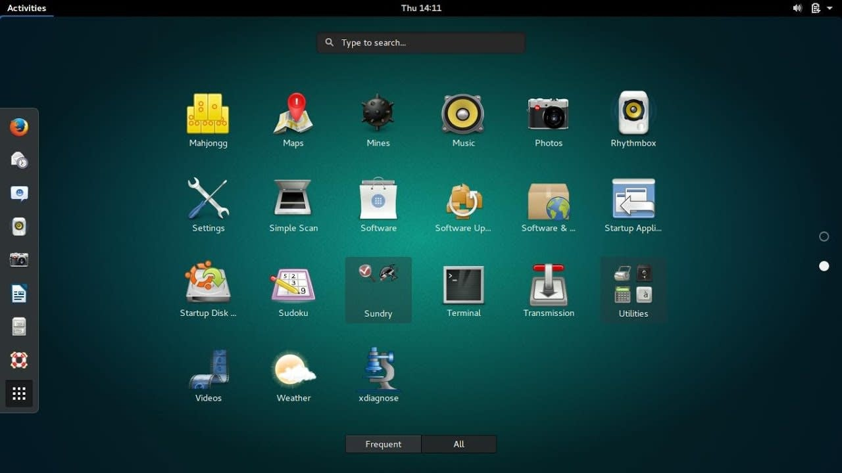


Linux operating system
1. Define: Hardware management (windows)
2. Define: Hardware management (Linux)
3. Use Terminal in Ubuntu to manage hardware

Slide 2

Advantages of Linux
The biggest advantage of the Linux system is that it is free to use
The Linux security feature is the main reason that it is the most favorable option for developers
It is open-source, anyone having programming knowledge can customize the operating system
Free
Security
Linux
open-source

Slide 3
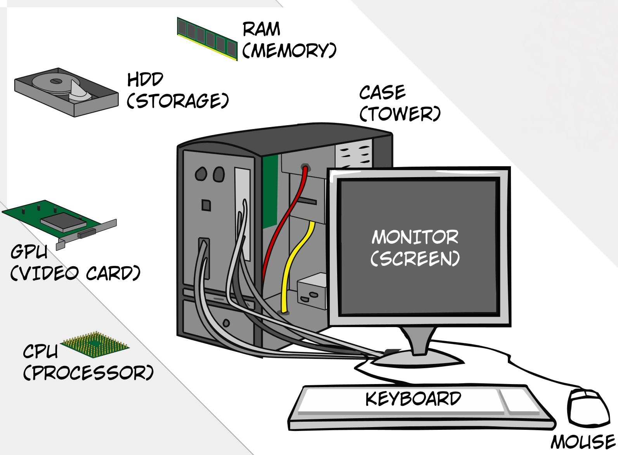
List of Computer Hardware

Slide 4

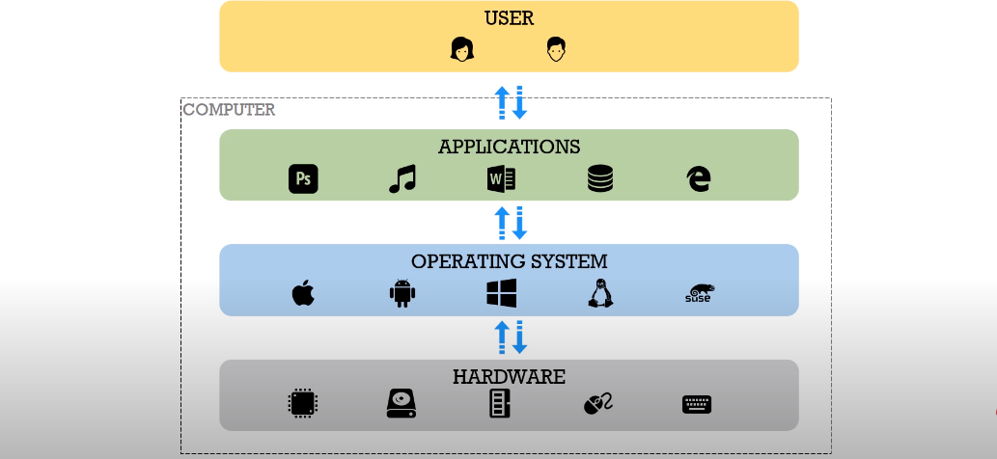
What is hardware management in operating systems ?
How to check system hardware information in windows ?
How to check system hardware information in Linux?
Communicates and translates all interactions between the user and the CPU

Slide 5
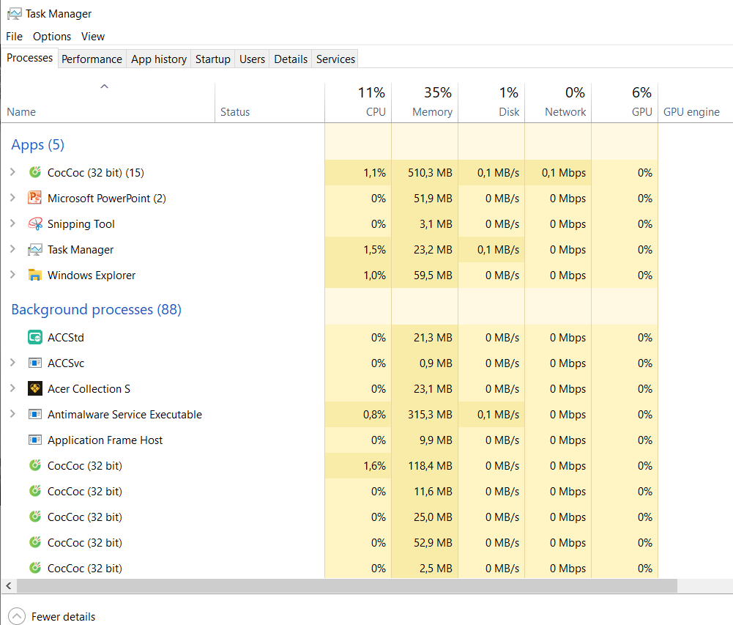
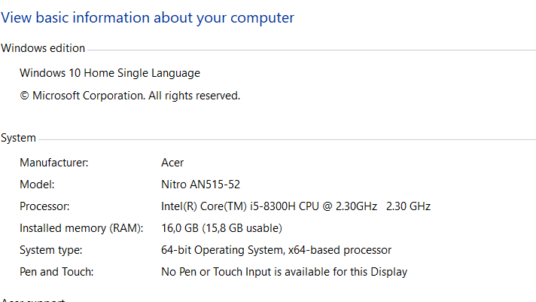
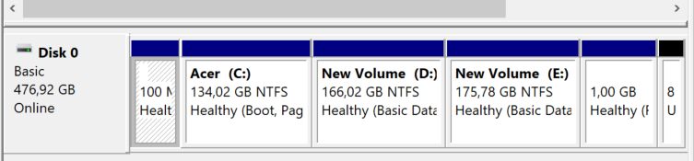
How to check system hardware information in windows ?
In windows operating system it is very easy to check hardware information,
but in Linux we have to use Terminal to check them.

Slide 6
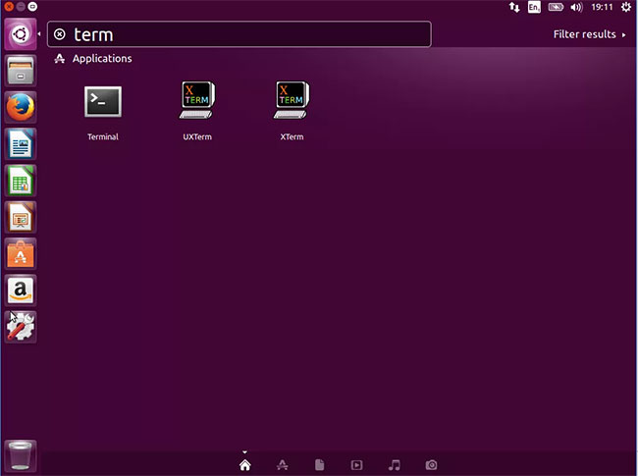
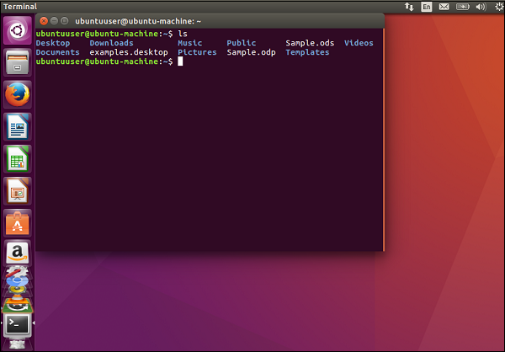
What is terminal in Ubuntu ?
It provides an interface into which users can type commands and that can print text. When you SSH into your Linux server, the program that you run on your local computer and type commands into is a terminal

Slide 7
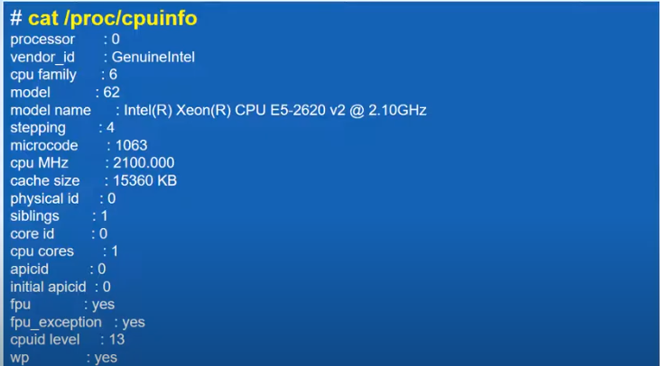
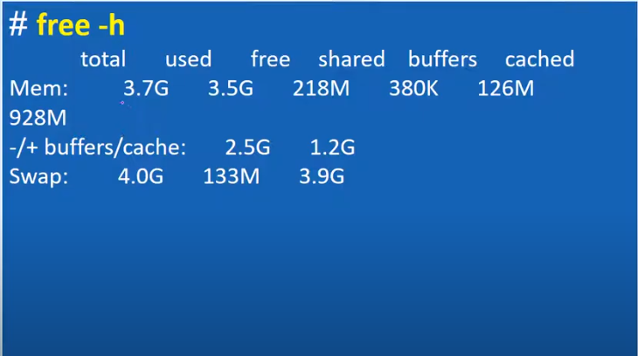
How to check system hardware information in Linux?
CPU
RAM

Slide 8

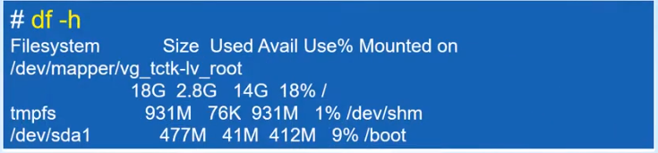
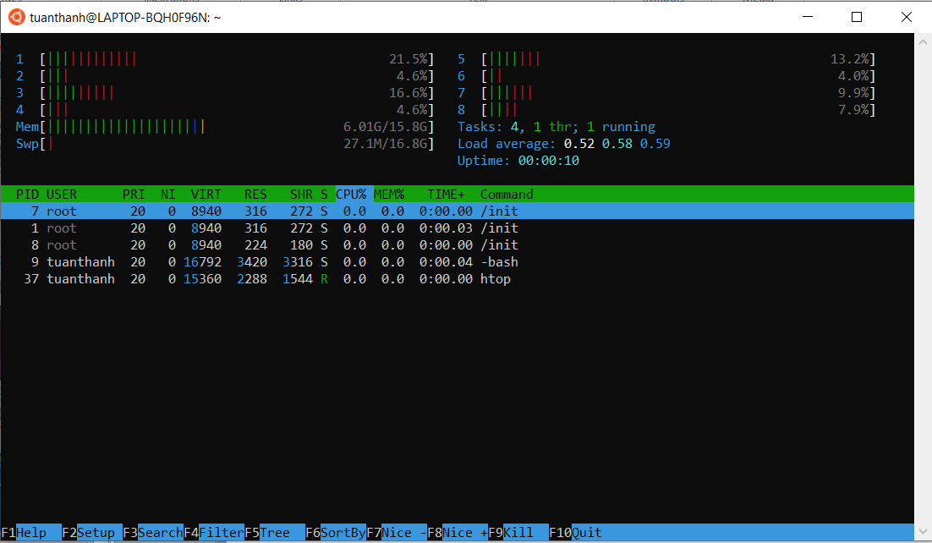
How to check system hardware information in Linux?
Task Manager in Linux
HHD
Linux does not have "Task Manager" like Windows

